Slide 1
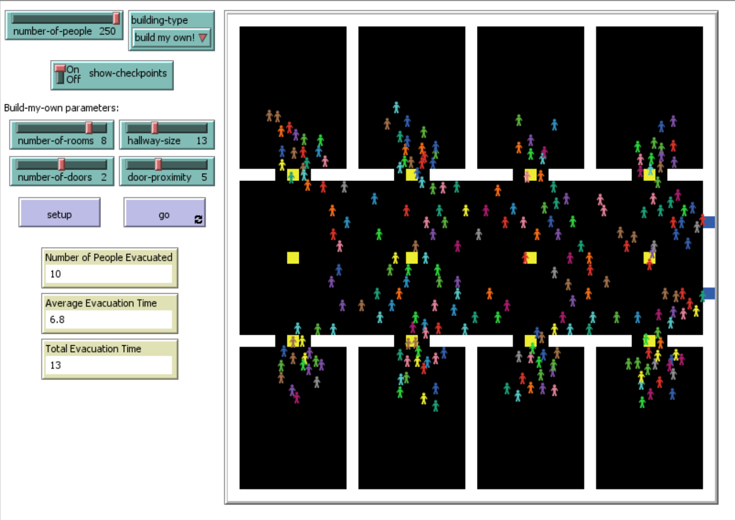
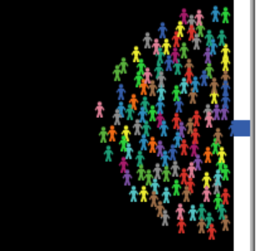
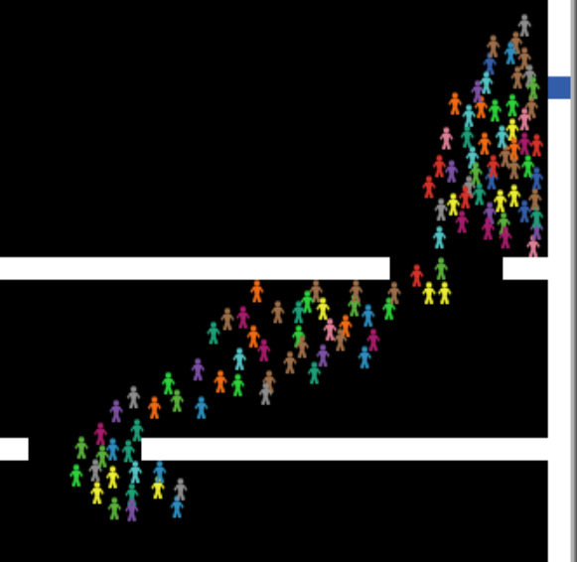






Emergency Evacuation
Spring 2018 EECS 372
Multi-Agent Modeling
Professor Uri Wilensky
Eric Hao
Motivation
It impacts real lives during emergencies
Agent-Based Modeling (ABM) can be applied naturally and intuitively
Applications extend beyond emergency readiness, including computer vision and swarm intelligence
Results
How It Works
At each tick, each person selects a target:
Select a visible exit. If there are none, then
Select a visible checkpoint. If there are none, then
Select a nearby visible spot
Pick an immediate-target based on target to move toward
Selection is based on five heuristics
Discussion
Having exits close together increases evacuation time, because crowds around two exits merge into a larger one. Exits too far apart are bad, too, because redistribution between exits takes longer. Larger hallways are better when there are not that many people, but it doesn’t matter much when there are lots of people. In general, more rooms are better, unless there are few people in the room.
The Five Heuristics
Crowdedness: How crowded is the patch?
Wall proximity: How many walls are near it?
Distance from me: How far away is it from me?
Distance from exits: How far away is it from exits?
Crowd direction: Is the crowd heading toward or away from it?
Emergent Behaviors
People clog around exits, forming a circular crowd:
People who cannot see exits try to follow the direction of the crowd, creating a herding or flocking behavior:
Possible Extensions
There are many ways to extend this model. Here are a few ideas:
Many buildings have tables or other miscellaneous obstacles
Can a purely heuristic model without checkpoints still exhibit realistic behavior?
Heuristic weights can be turned into tunable parameters
Heuristic Selection
Heuristic selection is handled differently when choosing different types of targets (exits, checkpoints, or regular patches). This is because the desirability of the heuristics varies depending on what type my target is. For example, if I am picking an exit, crowdedness is bad. However, if I don’t see any exits, then crowdedness is good.
Sensitivity Analysis
Three parameters were tested against number of people:
Door proximity (how close together exits are)
Hallway width
Number of rooms

